Slide 1

J2M Converter
Pooja Baba #002677117 MS in Computer Science (May 2023)
Dr. Raj Sunderraman (advisor) Professor and Associate Chair Department of Computer Science Georgia State University
Notes:
J2M: A JSONiq to MongoDB Converter

Slide 2



Agenda
Motivation
Problem Statement
Implementation Model
Demo
Conclusion
Future Work
References

Slide 3
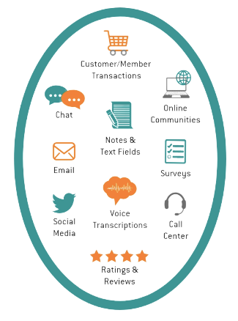
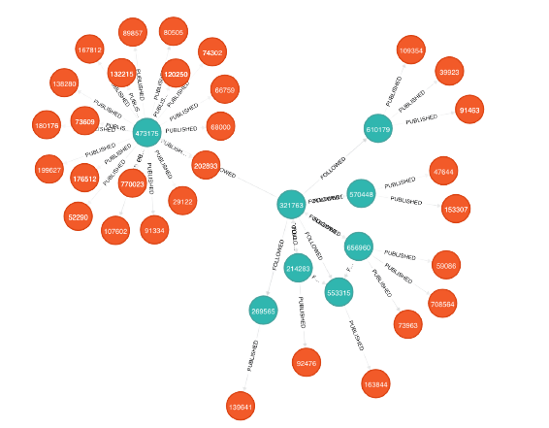
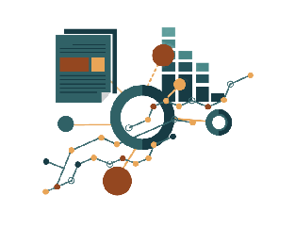
Motivation
Unstructured data is the new data - JSON
Efficient and easy data access
Numerous types of databases and query languages

Slide 4

Problem Statement
Different tools, databases, different query languages, syntax
Design a system that uses JSONiq to query from MongoDB

Slide 5


Some basics
Query language designed for popular JSON data model
JDM – JSONiq Data Model compatible with multiple JSON-like formats
JSONiq values – sequence of items, item can be atomic value, an object, an array, or a function item called dynamically
Classified as document-oriented NoSQL database program
Uses JSON-like documents with optional schemas
Uses MQL – MongoDB Query Language

Slide 6
Implementation Model
Input query (JSONiq)
Tokenize Input query
Generate AST (parser)
Check for semantic errors
Generate expression tree
Print data
Modify results
Execute query
(pymongo, MongoClient)
Create MongoDB query

Slide 7

Demo
Subtitle

Slide 8

Conclusion
J2M Converter bridges the gap between JSONiq query language and MongoDB
No extra cost of learning MongoDB query language

Slide 9

Future Work
FLWOR – For, Let, Where, Order, and Return clauses
Extend the Where clause by adding quantifiers – some and every
Implementing the same for Let and Order clauses
User Interface for interaction
Code customization to work with other JSON database systems – e.g., CouchDB and other NoSQL systems

Slide 10
References
Big Data for Engineers, Querying Trees, by Ghislain Fourny
PLY (Python Lex - Yacc) documentation
Python MongoDB (pymongo)
JSONiq documentation, JSONiq Book, by Ghislain Fourny

Slide 11


Thank You
Pooja Baba pbaba1@student.gsu.edu Website
Dr. Raj Sunderraman rajsunderraman@gsu.edu Website

